Slide 1
Making It Easier to do the Right Things:
Govern, Measure and Audit DevSecOps
Dragan Pleskonjic Senior Director Application Security, IGT
Colin Bell AppScan CTO, HCL Software
Rob Cuddy Application Security Evangelist, HCL Software

Slide 3

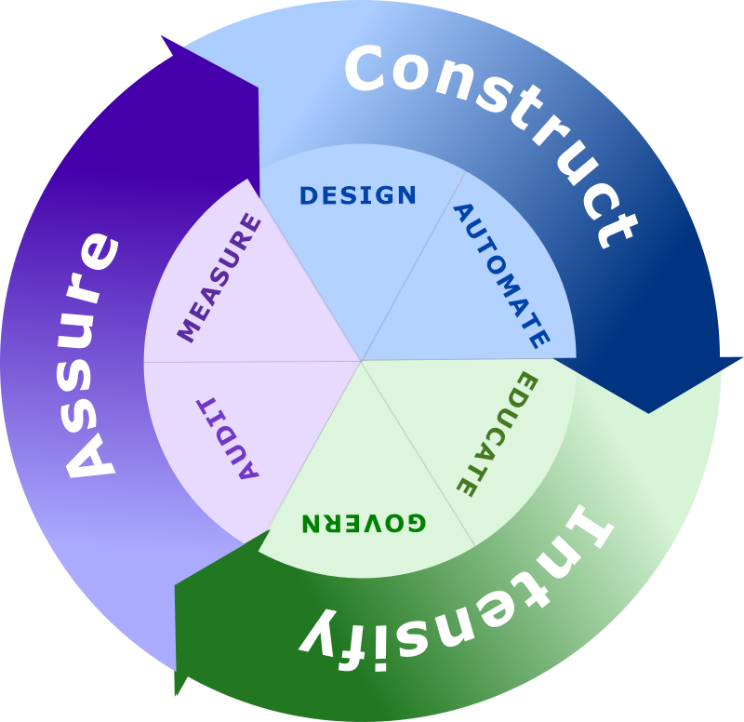

What is Continuous Security?
Construct
Secure by design and secure automation. This is the Secure DevOps piece or DevSecOps, but we need to expand security beyond just this…
Intensify
Magnifying the effort and impact, change the security culture, continue to improve. Education and governance drive this success.
Assure
Ensuring the controls are in place to meet the guidelines and standards we have in place. Secure Audit and Metrics are key to assure the program

Slide 4
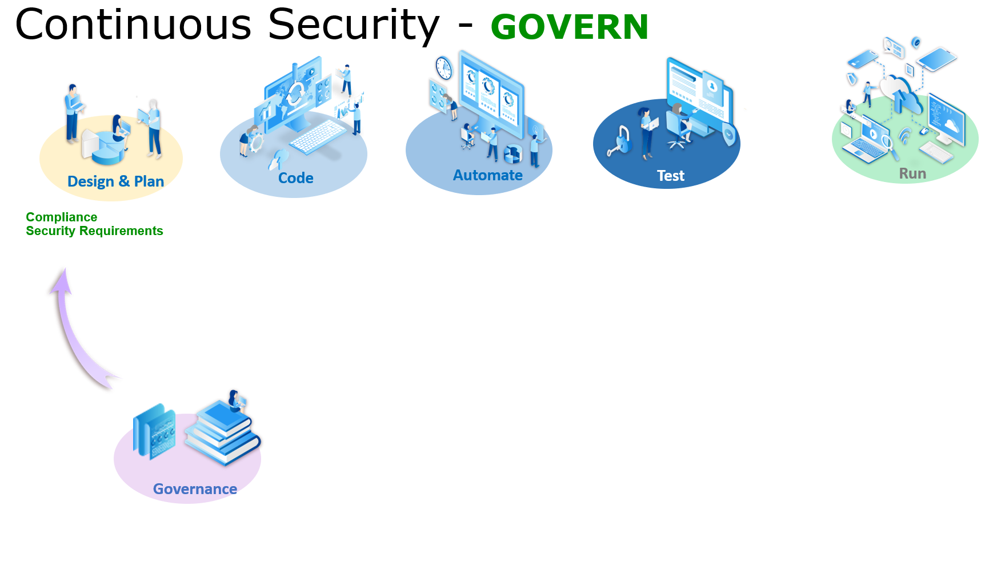

Slide 5
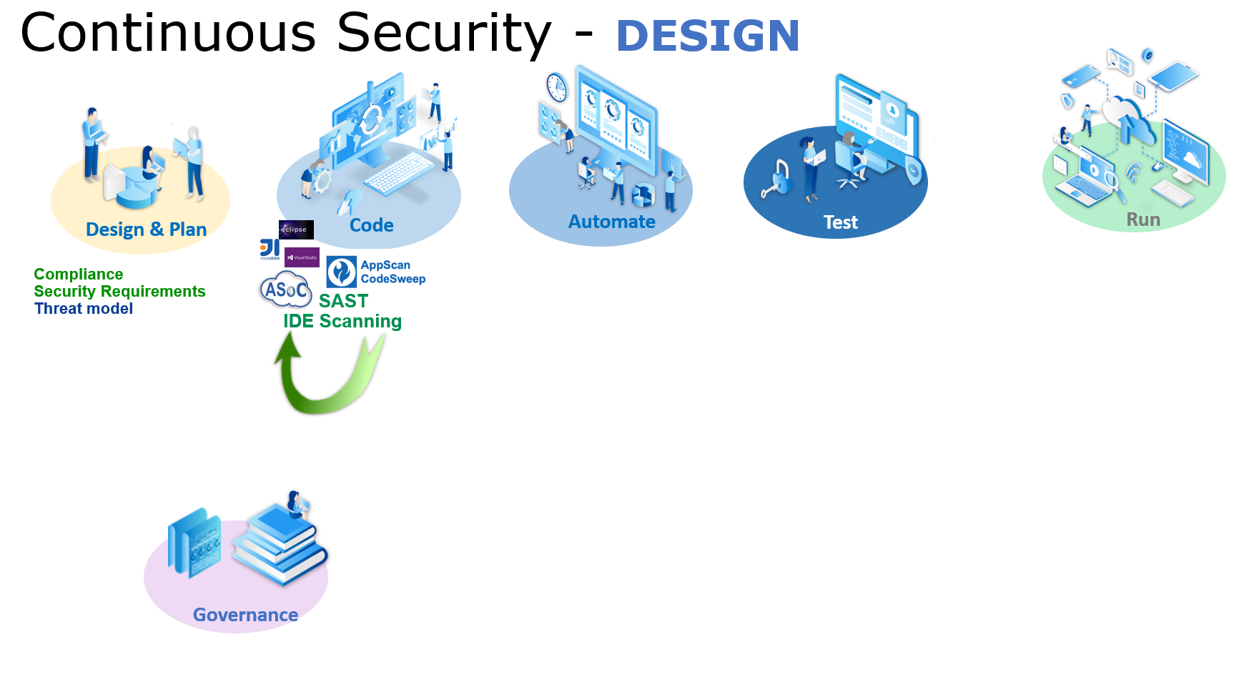

Slide 6
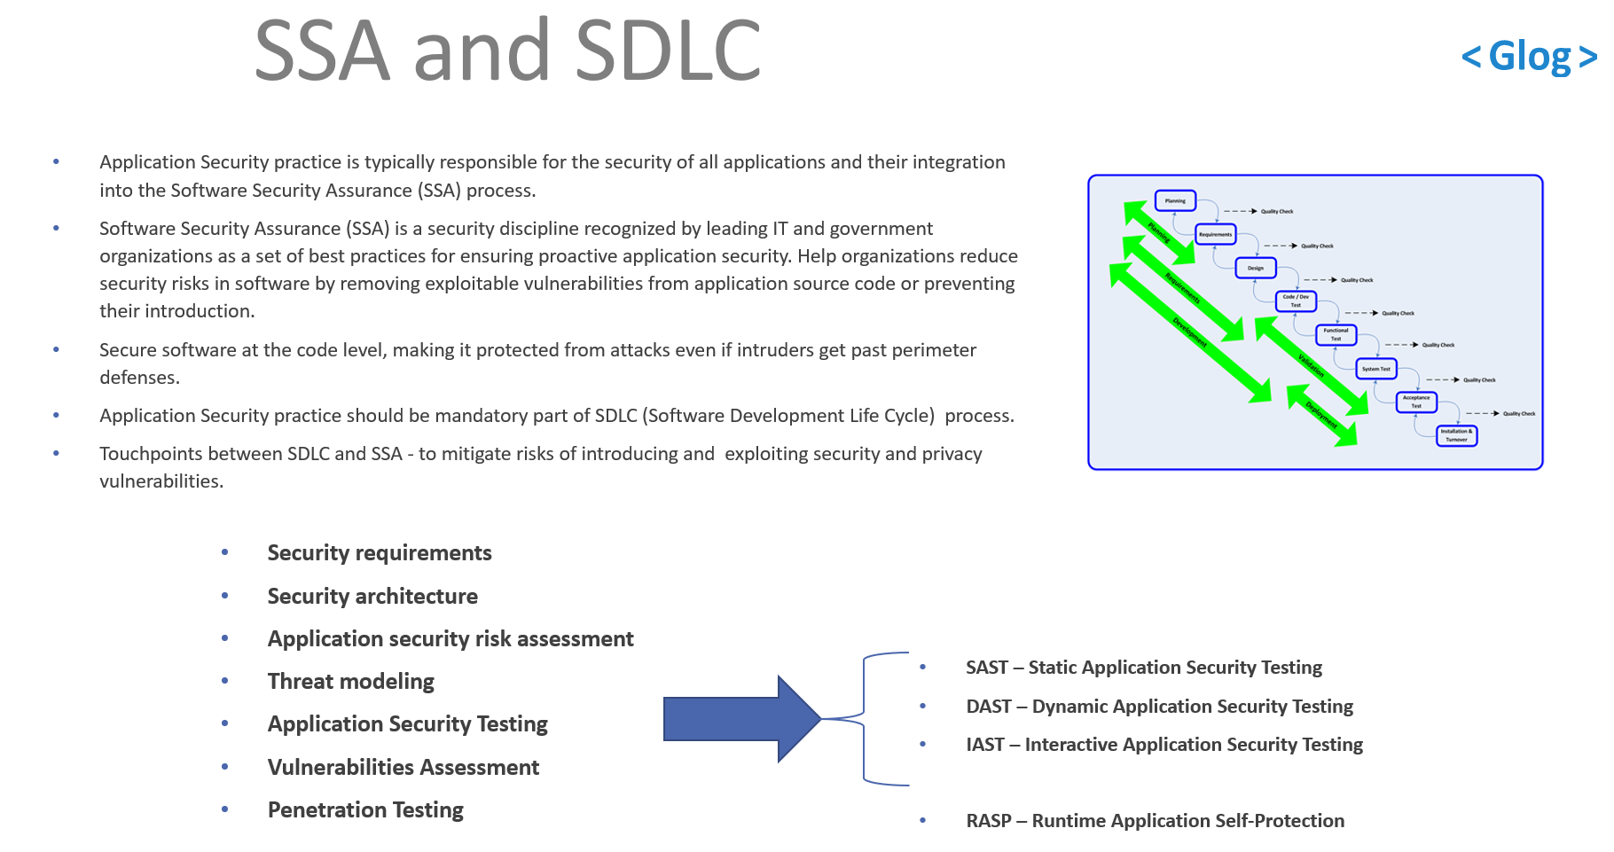

Slide 7
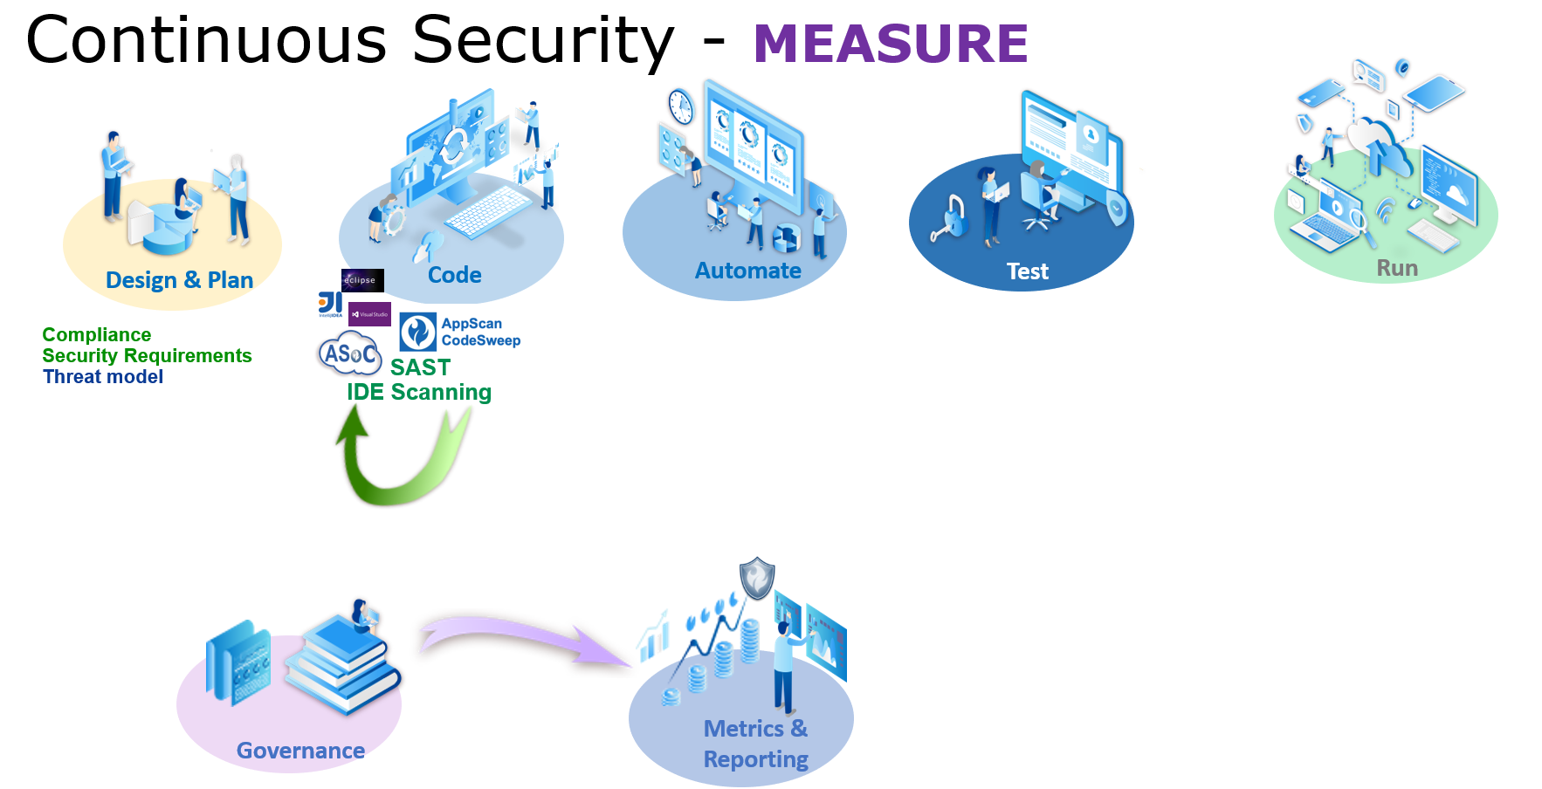

Slide 8
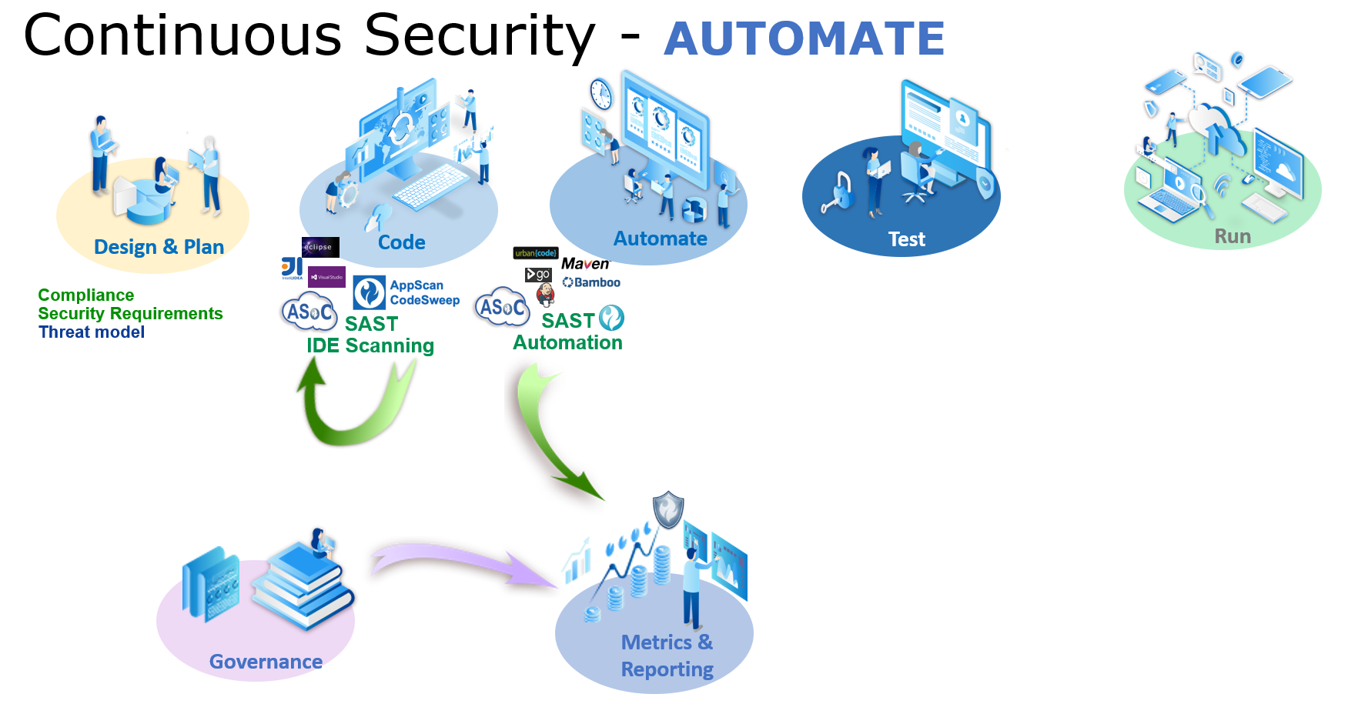

Slide 9
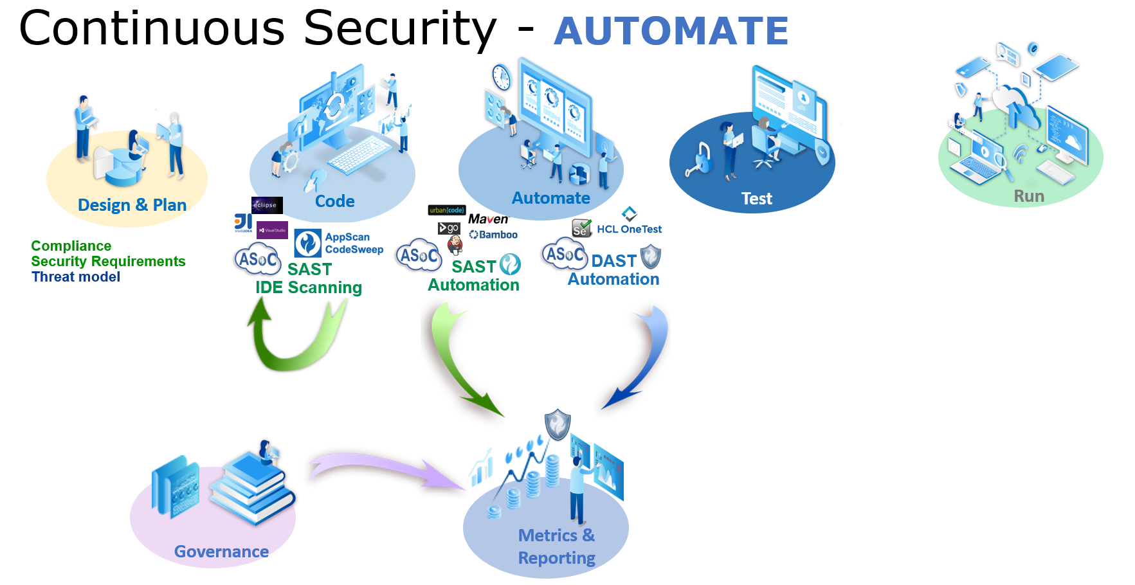

Slide 10
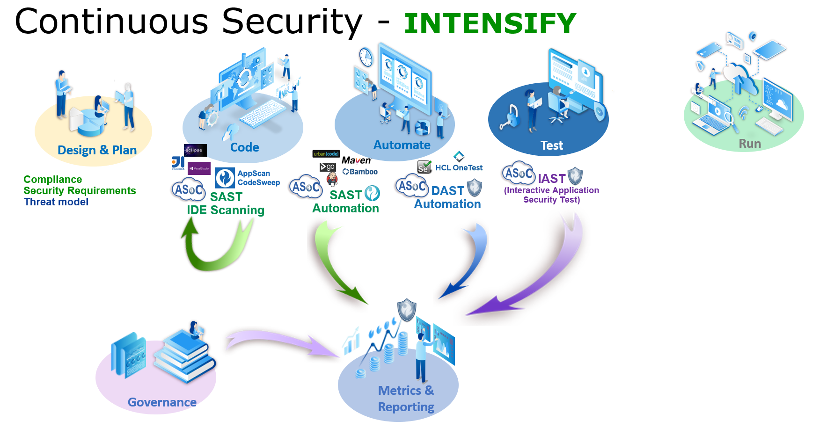

Slide 11
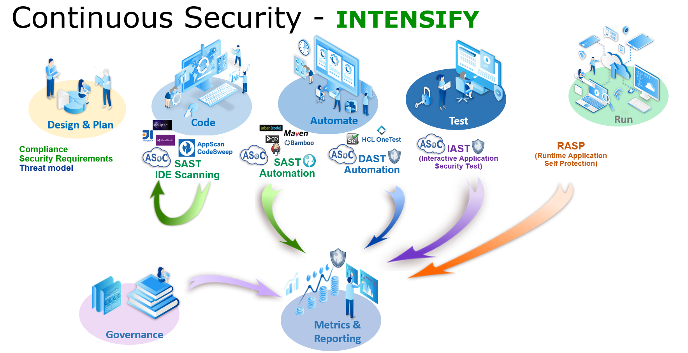

Slide 12
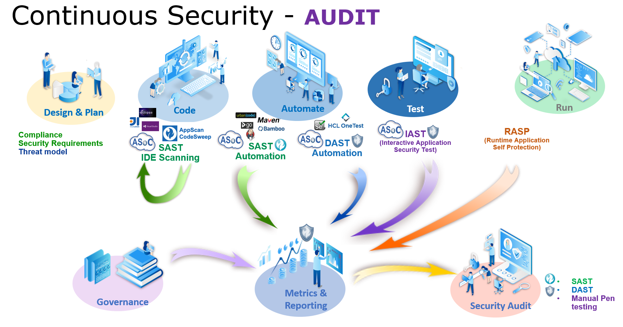

Slide 13
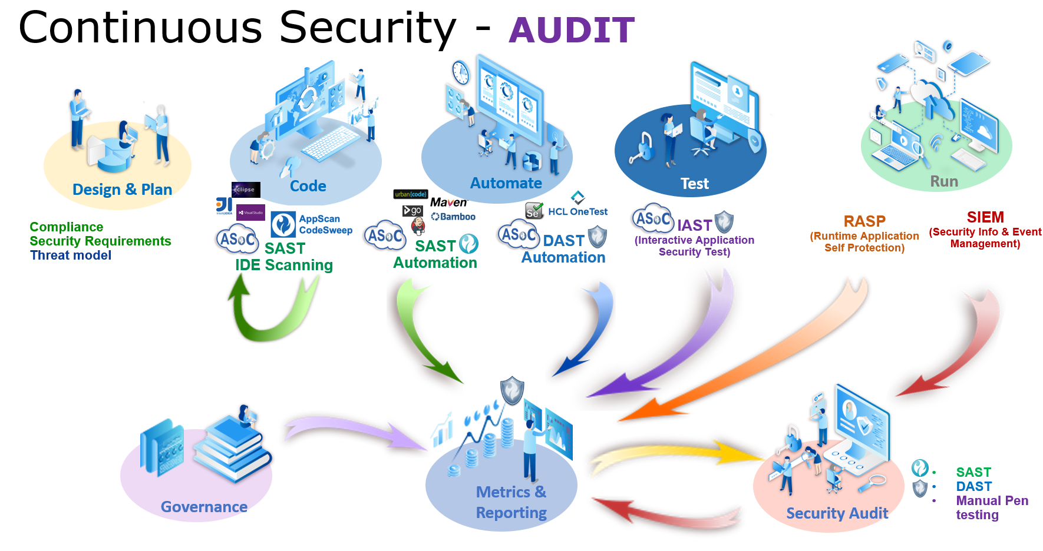

Slide 14
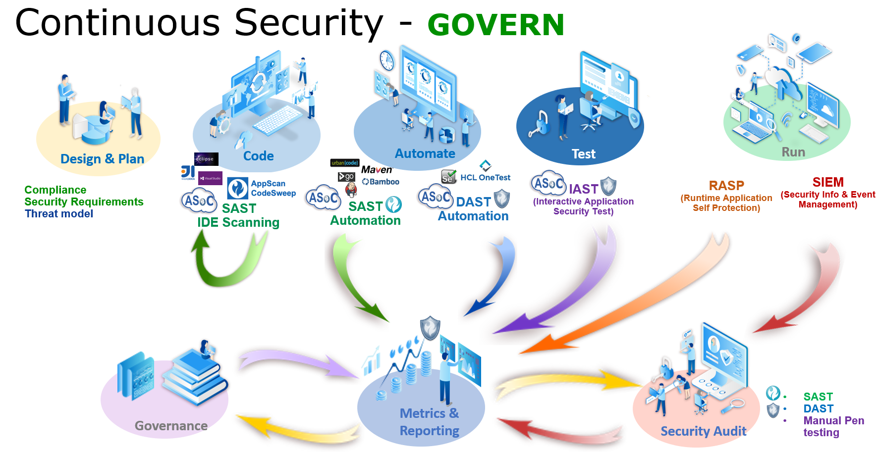

Slide 15
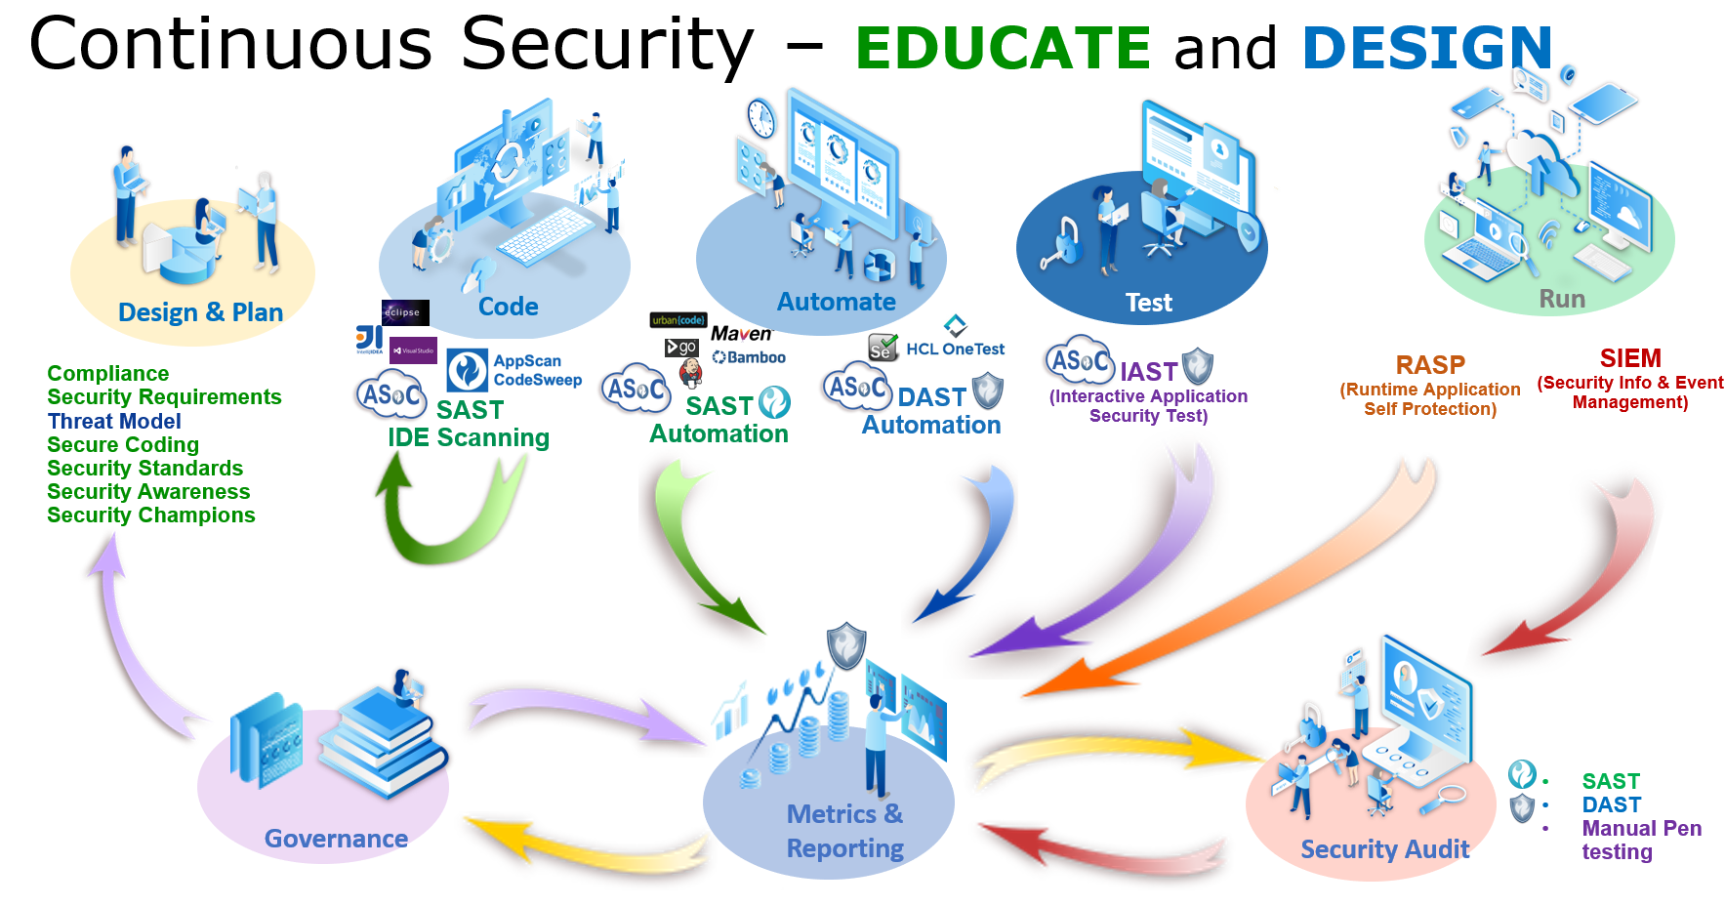

Slide 16
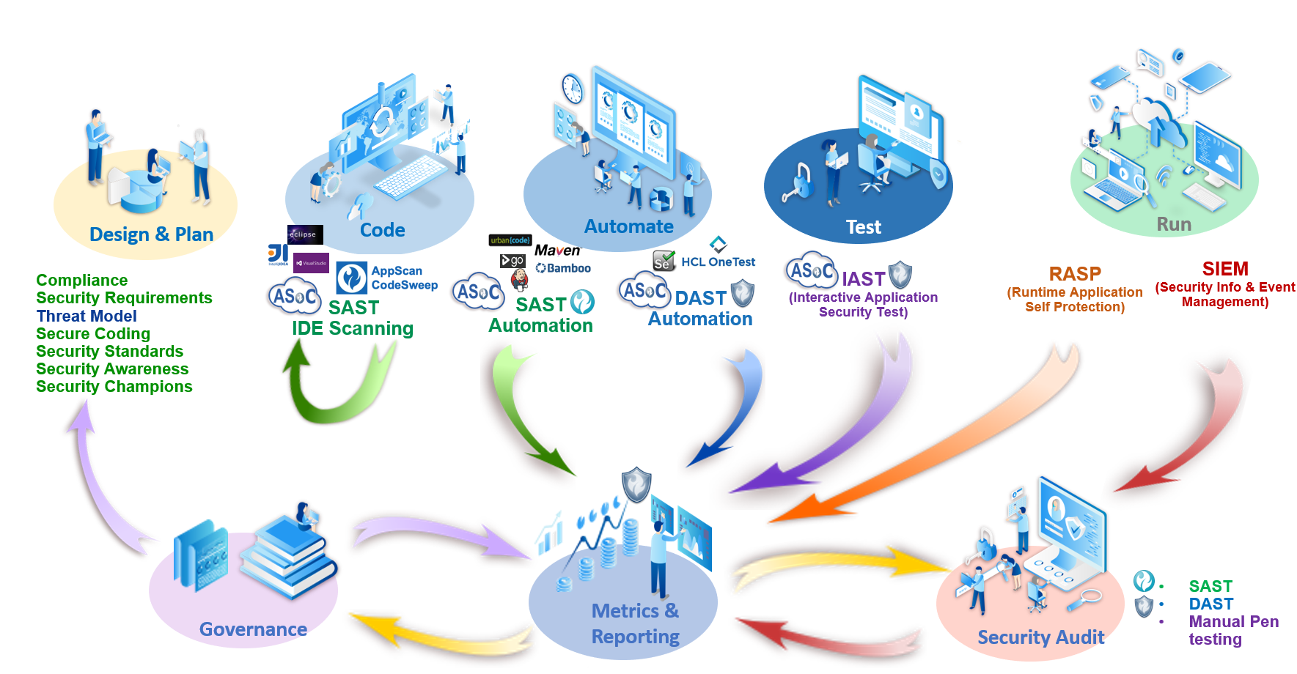
This is Continuous Security!

Slide 17
Making It Easier to do the Right Things:
Govern, Measure and Audit DevSecOps
THANK YOU

Slide 18
